Slide 1
Preparing Now for Accommodations and Assistive Technology in College
Steven Bianco, Florida SouthWestern State College, Coordinator of Accessibility & LMS Administration, Office of Information Technology

Slide 2

Disclosure
The software and websites linked within does not indicate an endorsement and is provided for informational purposes. Do not install any software without first running a virus scanner, software may require an administrator to install or implement, read the terms for any copyright information and licensing requirements.
All information is provided on an as-is basis for the purposes of education and research direction. As with any informational source your discretion is advised.

Slide 3

Presenter Information
Canvas course content accessibility
Document accessibility
Vendor Voluntary Product Accessibility Template (VPAT™) review
Website Accessibility

Slide 4
Overview
Assistive Technologies
Graphic Organizers
Note Taking
Speech to Text
Text to Speech (TTS)
Universal Design for Learning
Multiple Means of Engagement
Multiple Means of Representation
Multiple Means of Action and Expression
Quick Takeaways
Questions?

Slide 5
Assistive Technologies
Assistive technology (AT) is any item, piece of equipment, software program, or product system that is used to increase, maintain, or improve the functional capabilities of persons with disabilities. (Young & MacCormack, 2014).

Slide 6
Graphic Organizers (1 of 2)
“A graphic organizer is a visual display or chart that shows the relationship between ideas, facts, and information” (Alber, 2016).
Student Support
UDL
Tools

Slide 7
Graphic Organizers (2 of 2)
The use of graphic organizers relates to the Universal Design for Learning framework for checkpoints 3.2, 3.3, and 6.3. There are many free tools to create graphic organizers, notably within Microsoft Office (version 2007 and up) there is SmartArt (shown to right).
The major consideration when selecting a software (program-based or web-based) is the ability to create and disseminate accessible formats. Basic considerations are text-to-speech optimization, keyboard accessibility, and the ability to transition to a different format.
Student Support
UDL
Tools

Slide 8
Note Taking
Free or Low Cost
OneNote
Pen and Paper with Microsoft Office Lens
High Cost
Livescribe Pens
Sonocent

Slide 9
Speech to Text
Free or Low Cost
Dictation in Microsoft Office
Google Drive
Microsoft Teams Live Transcription
Web Captioner
High Cost
Dragon Speech Recognition
Otter.ai Transcription
Verbit.ai Transcription
Zoom Live Transcription

Slide 10
Text to Speech (TTS)
Free or Low Cost
Balabolka
Built-in Screen Readers
Microsoft Edge Browser
Microsoft Immersive Reader
Non-Visual Desktop Access (NVDA)
High Cost
Job Access with Speech (JAWS)
Kurzweil 3000
Read&Write
Scanning Pens

Slide 11
Universal Design for Learning
CAST. (2018). Universal design for learning guidelines, version 2.2. Center for Applied Special Technology (CAST).

Slide 12
Multiple Means of Engagement
Provide options for Recruiting Interest:
Minimize threats and distractions (7.3).
Provide options for Sustaining Effort and Persistence:
Heighten salience of goals and objectives (8.1).
Vary demands and resources to optimize challenge (8.2).
Increase mastery-oriented feedback (8.4).
Provide options for Self Regulation:
Promote expectations and beliefs that optimize motivation (9.1).
Facilitate personal coping skills and strategies (9.2).
Develop self-assessment and reflection (9.3).

Slide 13
Multiple Means of Representation
Provide options for Perception:
Offer ways of customizing the display of information (1.1).
Offer alternatives for auditory information (1.2).
Offer alternatives for visual information (1.3).
Provide options for Language and Symbols:
Clarify vocabulary and symbols (2.1).
Clarify syntax and structure (2.2).
Support decoding of text, mathematical notation, and symbols (2.3).
Illustrate through multiple media (2.5).
Provide options for Comprehension:
Activate or supply background knowledge (3.1).
Highlight patterns, critical features, big ideas, and relationships (3.2).
Guide information processing and visualization (3.3).
Maximize transfer and generalization (3.4).

Slide 14
Multiple Means of Action and Expression
Provide options for Physical Action:
Vary the methods for response and navigation (4.1).
Optimize access to tools and assistive technologies (4.2).
Provide options for Expression and Communication:
Use multiple media for communication (5.1).
Use multiple tools for construction and composition (5.2).
Build fluencies with graduated levels of support for practice and performance (5.3).
Provide options for Executive Functions:
Guide appropriate goal-setting (6.1).
Support planning and strategy development (6.2).
Facilitate managing information and resources (6.3).
Enhance capacity for monitoring progress (6.4).

Slide 15
Quick Takeaways

Slide 16
Easy Things to Implement
Help users understand what things are and how to use them.
Help users find what they need.
Use clear content (text, images and media).
Help users avoid mistakes.
Help users focus.
Ensure processes do not rely on memory.
Provide help and support.
Support adaption and personalization.
Source: Seeman-Horwitz, L., Montgomery, R., Lee, S., Ran, R. (eds.). (2021, April 29). Making content usable for people with cognitive and learning disabilities. W3C.

Slide 17
Questions?
Please use the next five (5) to ten (10) minutes to ask questions and discuss with the presenter.

Slide 18
References
Alber, R. (2016, October 13). Using graphic organizers correctly. Edutopia.
CAST. (2018). Universal design for learning guidelines, version 2.2. Center for Applied Special Technology (CAST).
Seeman-Horwitz, L., Montgomery, R., Lee, S., Ran, R. (eds.). (2021, April 29). Making content usable for people with cognitive and learning disabilities. W3C.
Young, G., MacCormack, J. (2014, June 10). Assistive technology for students with learning disabilities. Learning Disabilities Association of Ontario.

Slide 19
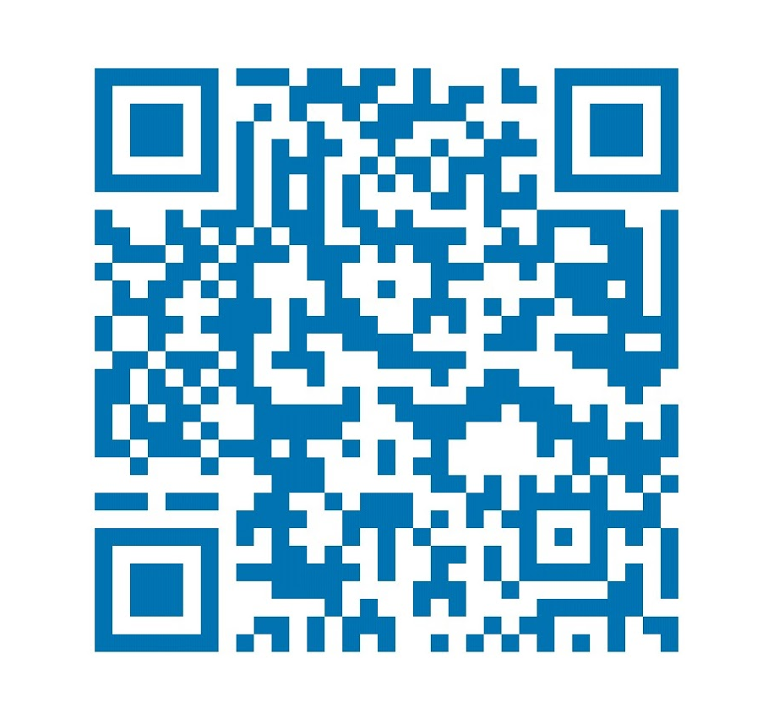
Thank You!
Steven Bianco
Email: sbianco@fsw.edu
LinkedIn: sjkbianco

